Slide 1

SAGE GAMEFUL CONSTRUCTIONISM ASSESSMENTS - Midterm
JOHAN SULAIMAN

Slide 2
PROJECT MOTIVATION
The past 3 years of SAGE development has created various modules and functionalities. Our continued focus remains in maximizing Social Addictive Gamefulness during instillation of computational thinking especially during assessments of Gameful Constructionism learning, but with the added awareness that there is also a growing need to provide up-to-date, unifying structure on the conceptual and architectural level with a Gameful orientation. In an iterative manner, during the process of building a platform that supports Engineering activities, the platform itself requires frequent (Re-)Engineering. Achieving this will allow for better cross-module integration, research clarity, and enablement of a more formal experimentation and evaluation of the effectiveness of SAGE modules.

Slide 3

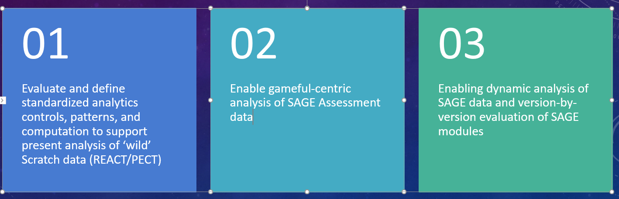
PROPOSAL – REALIZE A GAMEFUL EVALUATION SYSTEM AND ANALYTICS FRAMEWORK
Proposed parallel tracks that are in-sync and inform each other:
Assessment
1
2
3
4
Enable real-time Gameful assessments in the Node.js version of SAGE to support Gameful Constructionism usage of Scratch
Translation of the terminologies and structure into a shared and unified nomenclature defined within the SAGE Gameful Framework (ECD/ADAGE)
Overhaul fun and inviting Game Objectives in a Gameful UI (Point value, Progress Bar, Quantification of Assessed Steps)
Persistent Gameful progress keeping, completion, summary, tracker
Analytics

Slide 4
MILESTONES
10/12
Current State Development Environment Setup
11/09
Successfully port and verify all Go-based Assessment Server functionalities to Node.js
11/09
Create a SAGE data analytics framework to support dynamic analysis of 'wild' and SAGE scratch data
11/30
Complete baseline analysis using SAGE data analytics framework against wild Scratch data
11/30
Add Gameful Constructionism enhancements into the Assessments module
12/07
Final Report
12/21
Software Documentation, SAGE Wiki update, and Code migration to Github repositories

Slide 5
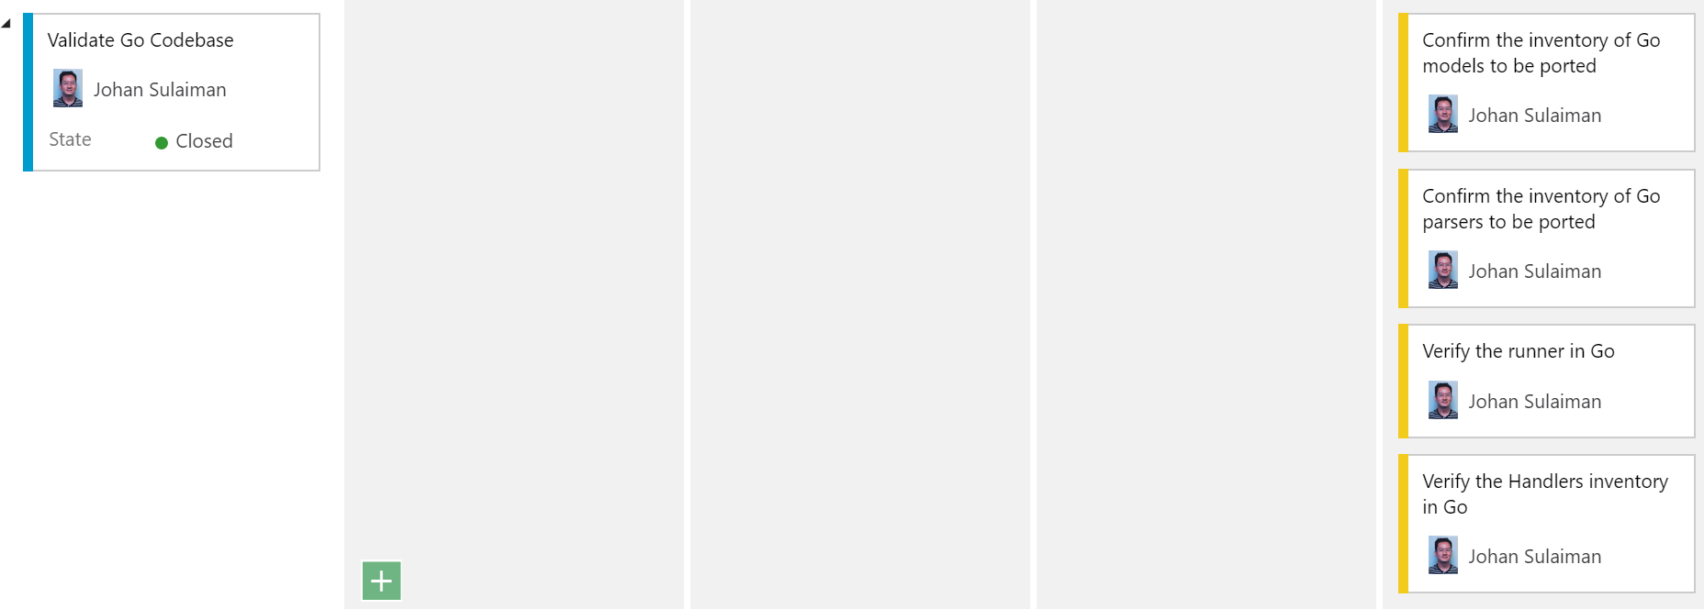
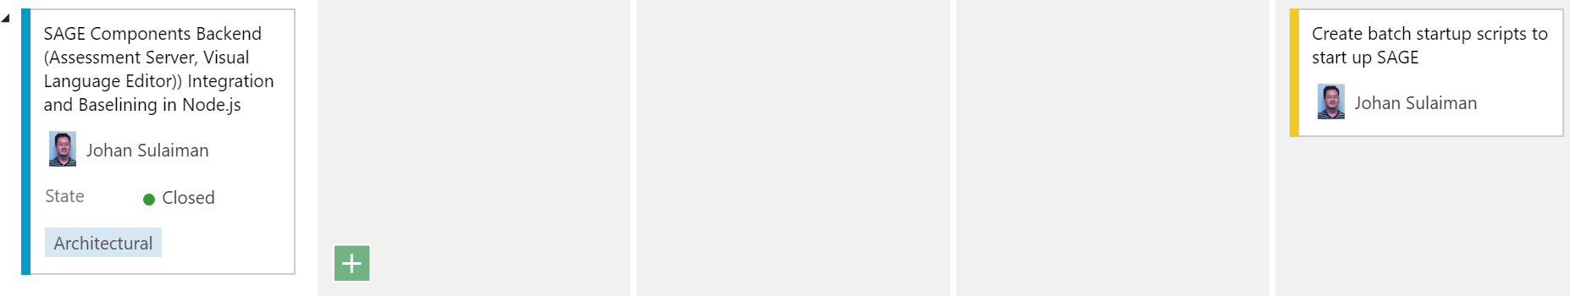
Sprint 1 - Validate Existing Go components

Slide 6
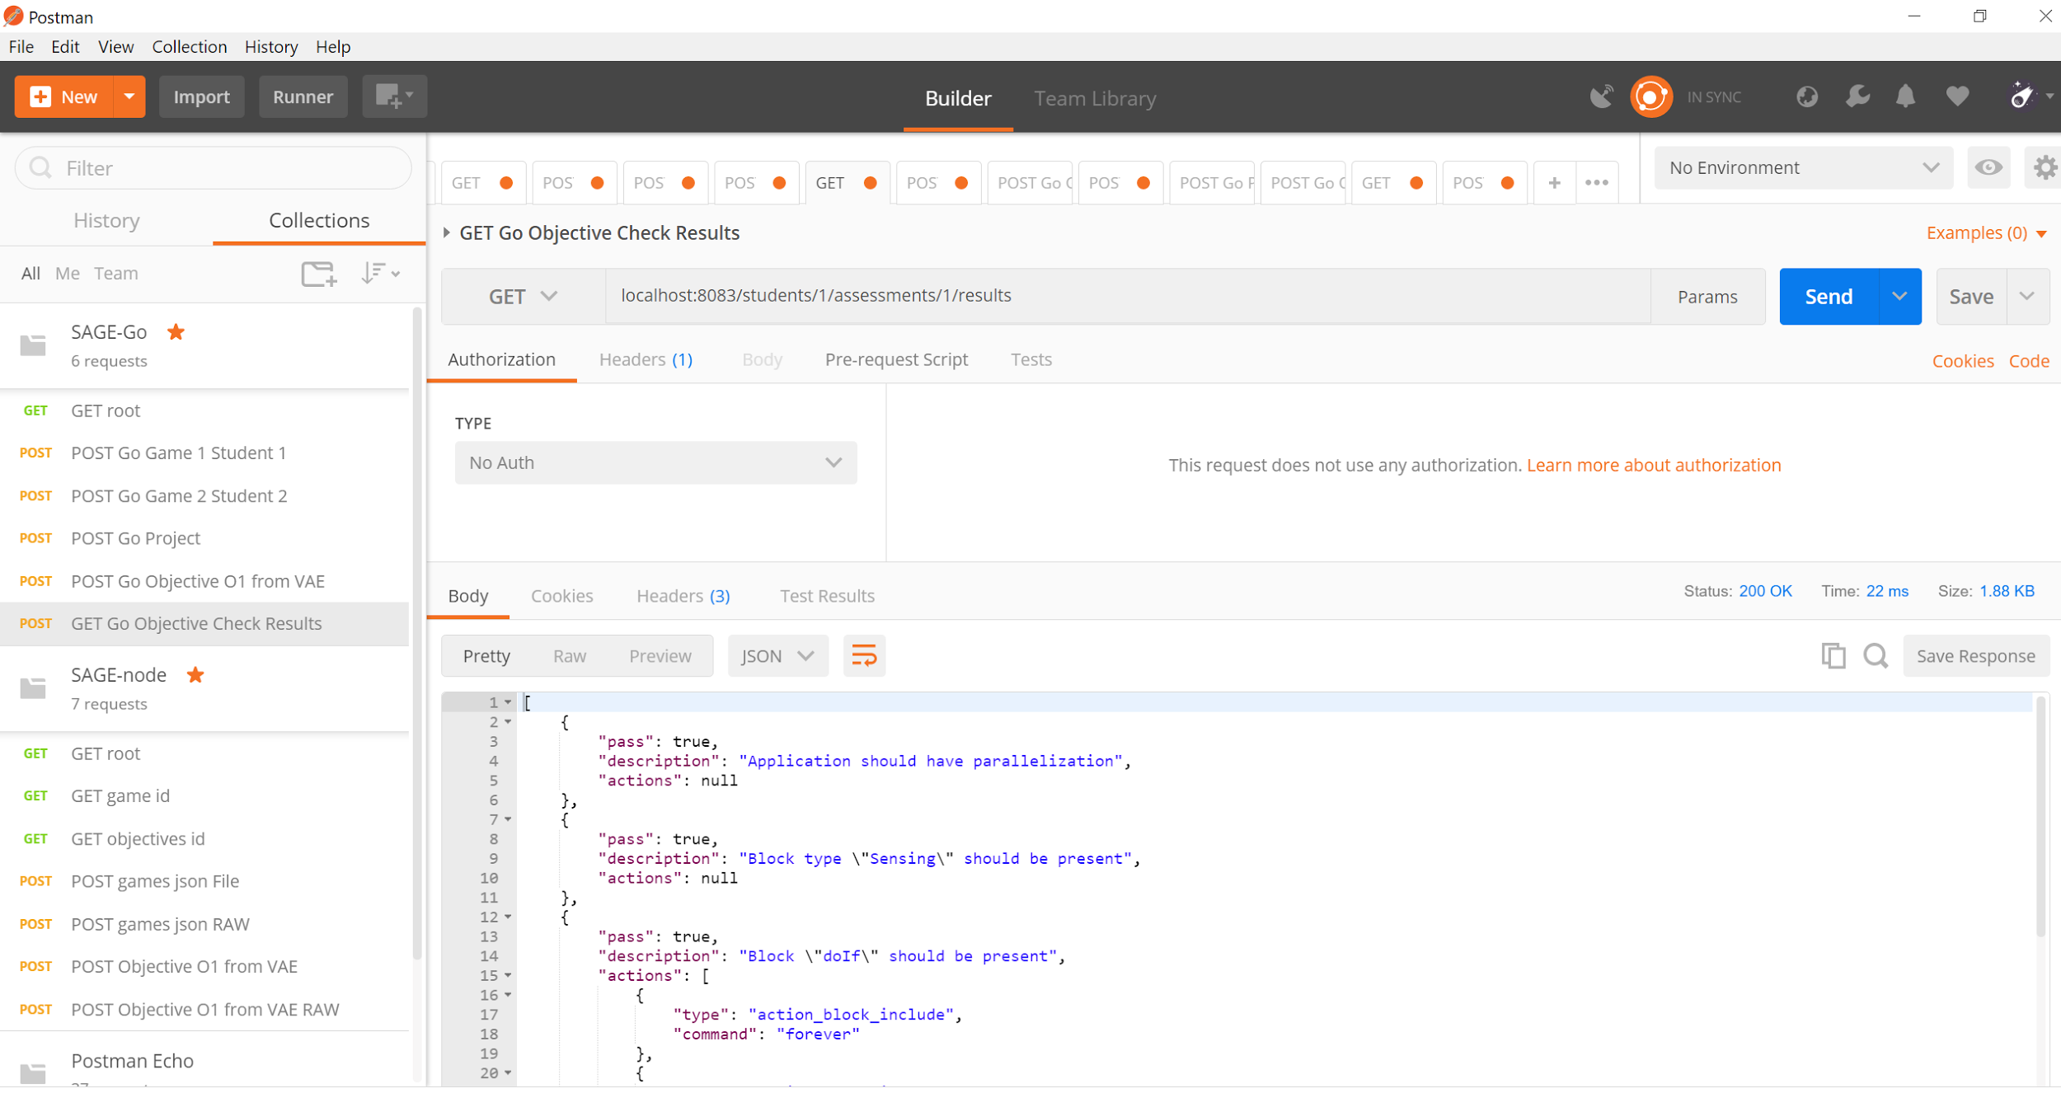
Sprint 1 - Go Validation Method - Postman

Slide 7
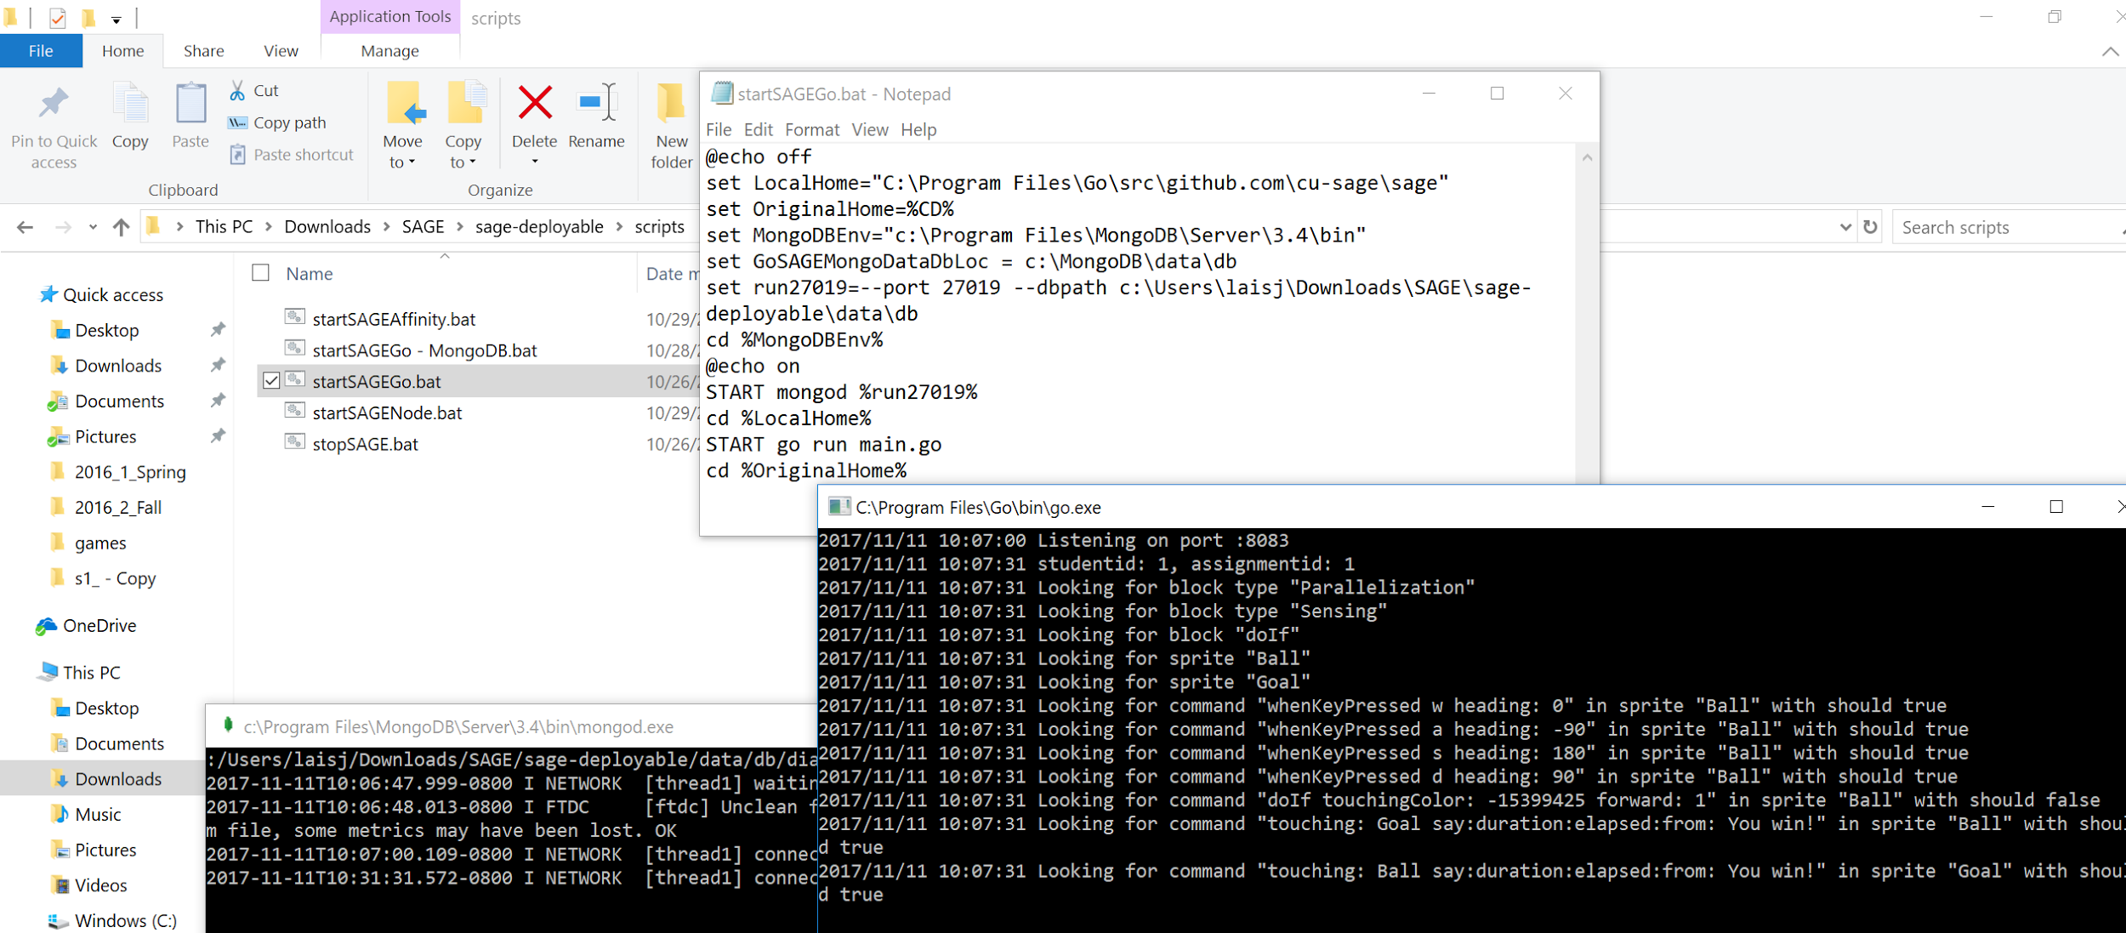
Sprint 1 - Start up Go and Node.js

Slide 8
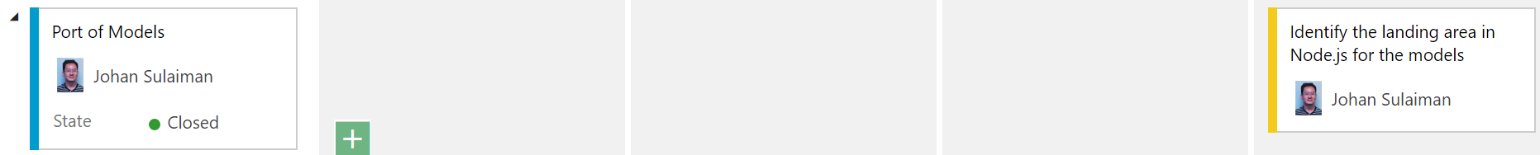
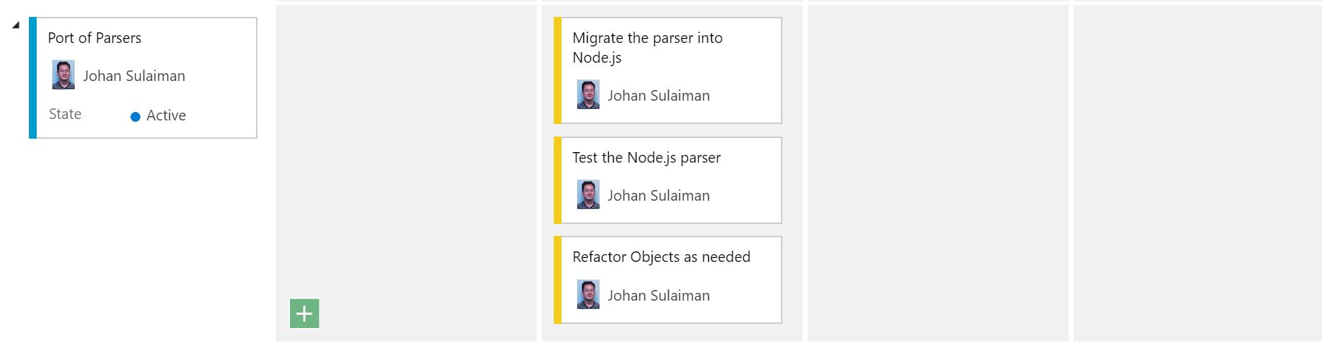
Sprint 2 - Porting and Renaming Models, Handlers, Parsers

Slide 9
Sprint 2 - Porting and Renaming Models, Handlers, Parsers
Some nomenclature changes:
SAGE Assessment Server (Go) | SAGE Assessment Server (Node.js)
Project | Game
Assessment | GameObjective - FormativeAssessment
Progress | Progress: Evaluation of CT concepts - Summative Assessment
Handlers | Controller (Router)
- | Service

Slide 10
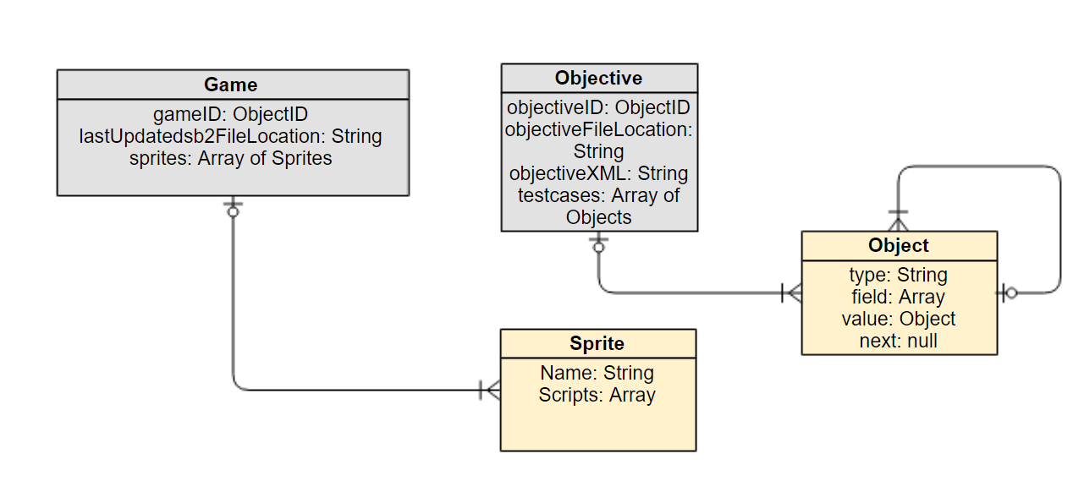
Sprint 2 - Games and Objectives MongoDB ODM

Slide 11
Looking Ahead
Complete and validate Model, Handler, Parser, Runner ports
Syncing of the terminologies and structure into a shared and unified nomenclature beyond just SAGE Assessment Server (i.e. Affinity Space by discussing with Sudanshu (open game, make sure it loads))
Add Gameful Constructionism enhancements into the Assessments module
Notes:
Feedback:
How to handle Progress and Game receiving sb2s one-time? Accept the entire sb2 game (the full project). Want to avoid sending updates twice (to Progress and Game).
Editor sends JSON and full sb2, being handled by Progress, supposed to save JSON every second, and the full sb2 on Save.
Integrate Progress, Game, Objective.
Currently Progress in Node can accept Editor sb2 via REST api POST
Is there a GET back to Editor? Look into FetchAssignmentProgress.
We need to load Scratch Editor from the Assessment Server instead of file system.

